Slide 1


Artificial Intelligence and Data Science
Data Science and Visualization
24ADI204
MID REVIEW (September 2026)
Team No: 16
Team Number: Anireetha M
Atchaya S
Lakshmi Prabha M M
Madhumitha S
DATA-VIZ HACK-A-BIT (2026-2027)

Slide 2


Problem Statement
“Youth Smoking and Drug Abuse Analysis ”
Youth smoking and drug abuse can be influenced by demographic, behavioral, and personality-related factors. Understanding these factors can help identify patterns associated with higher-risk substance consumption.
This project aims to analyze drug consumption patterns, study demographic and personality factors, identify relationships among variables .
SDG Alignment:
SDG 3 — Good Health and Well-being

Slide 3
Project Objectives
PROJECT OBJECTIVES
  Analyze youth smoking and drug-consumption patterns.
  Study the influence of demographic factors such as age, gender and education.
  Analyze personality traits associated with substance consumption.
  Handle missing values and encoded categorical variables.
  Detect and investigate potential outliers.
  Identify relationships between demographic, personality and consumption variables.
  Identify factors associated with higher-risk consumption.
  Create meaningful visualizations and dashboard insights.

Slide 4
Dataset Description
  Source: Kaggle / UCI Machine Learning Repository UUCI Machine Learning Repository
  Number of Records: 1,885 respondents
  Number of Features: 32 columns
  Target Variable: Drug consumption / risk category
  Data Type: Structured, multivariate tabular dataset
  Main Feature Groups: Demographic, Personality, and Drug Consumption
  Demographic Features: Age, Gender, Education, Country, Ethnicity
  Personality Features: Nscore, Escore, Oscore, Ascore, Cscore, Impulsive, SS
  Drug Variables: Alcohol, Cannabis, Cocaine, Heroin, Ecstasy, LSD, Meth, Mushrooms, Nicotine, etc. UUCI Machine Learning Repository
  Missing Values: The Kaggle educational version introduces 452 missing values across 4 columns for data-cleaning practice.

Slide 5
Methodology(Process / Workflow)
Dataset Collection
↓
Know Your Data
↓
Data Cleaning
↓
Missing Value Imputation
↓
Outlier Detection
↓
Exploratory Data Analysis
↓
Univariate Analysis
↓
Bivariate Analysis
↓
Correlation Analysis
↓
Feature Engineering
↓
Risk Classification
↓
Visualization / Dashboard

Slide 6
DATA PREPROCESSING
Data Quality Checks:
  Dataset shape: 1,885 × 32
  Data types examined.
  Missing values identified.
  Duplicate records checked.
  Unique values inspected

Slide 7
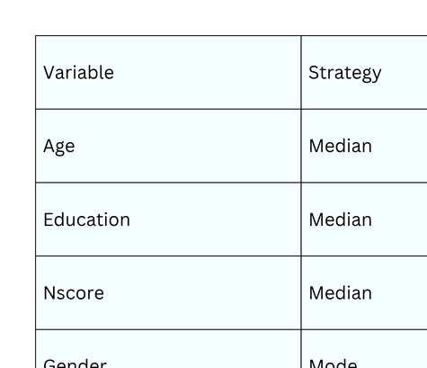
DATA PREPROCESSING
Missing Value Handling:
Result
  Missing values after imputation: 0
  Duplicate rows: 0
  Final shape: 1,885 × 32

Slide 8
OUTLIER DETECTION
Outlier Detection
  Two techniques were used:
Boxplot
  Used for visual identification of potential outliers.
  Observations beyond the whiskers were investigated.
Z-score
  Used to identify observations far from the mean.
  |Z| > 3 was considered a potential outlier.

Slide 9
OUTLIER DETECTION
Potential Outliers Identified
  Age — 16
  Ethnicity — 36
  Nscore — 4
  Escore — 6
  Oscore — 2
  Ascore — 5
  Cscore — 6
  Impulsive — 7
Note: Potential outliers were identified and reported rather than automatically remove

Slide 10
Results From Workflow
Data Cleaning
  Missing values successfully handled.
  No duplicate rows detected.
  Potential outliers identified for investigation.
  Dataset retained its original 1,885 × 32 structure.
EDA
  Demographic distributions analyzed.
  Education-level distribution analyzed.
  Personality-score distributions visualized.
  Drug-consumption distributions explored.
  Relationships between selected variables analyzed.

Slide 11
Results From Workflow
Visualization Techniques
  Count plots
  Histograms
  Boxplots
  Scatter plots
  Correlation heatmap

Slide 12
Expected Final Results
  Identify important patterns in youth smoking and drug consumption.
  Determine demographic and personality factors associated with consumption.
  Develop meaningful features for risk classification.
  Build a machine-learning model for consumption-risk prediction.
  Evaluate model performance using suitable metrics.
  Develop visualizations/dashboard insights for easier interpretation.
  Provide data-driven insights aligned with SDG 3 — Good Health and Well-being.

Slide 13
INTERACTIVE PYTHON FILE
LINK:
Team 16 ipynb

Slide 14
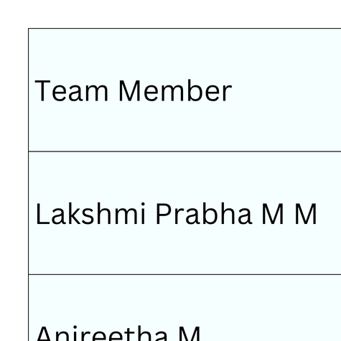
Roles & Responsibilities

Slide 15
References
  Kaggle — Drug Consumption (UCI) – Missing Values Dataset
  UCI Machine Learning Repository — Drug Consumption Dataset
  Kaggle Learn — Data Visualization
  Pandas Documentation
  NumPy Documentation
  Matplotlib Documentation
  Seaborn Documentation
  SciPy Documentation
  Scikit-learn Documentation

